Slide 1
Cambridge Advanced - speaking

Slide 2
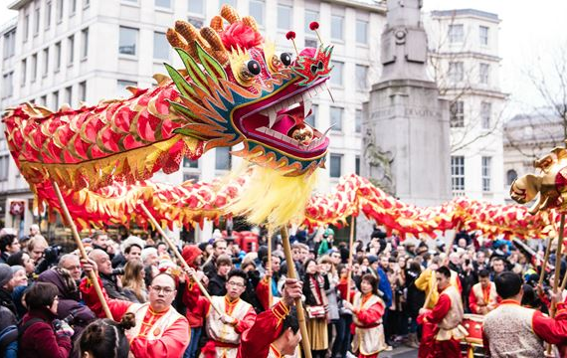
PART 2: comparison of photos

Slide 3
SPECULATION
"It looks like..." / "They look like..."
e.g. It looks like they´re on a mountain expedition...
"This could be..."
e.g. This could be a personal challenge, or they might be doing it because...
"Perhaps..."
e.g. Perhaps they are trying to work on their team building skills...
"Maybe..."
e.g. ...Or maybe they are focussing on improving their personal fitness
"It seems as though..."
e.g. It seems as though they are enjoying it, even if it has been a long and gruelling day...

Slide 4
REMEMBER!
You only need to talk about TWO of the three photographs
You should be comparing the photos, talking about similarities and differences, rather than simply describing
Don´t forget to answer the question that the examiner asks, and answer it with reference to the photographs
This part of the exam is testing your ability to speculate about what might be happening in the photograph, so be prepared to use some of the phrases from the previous slide and offer a few different ideas.
Try to keep talking until the examiner says "Thank you" (indicating your time is up). Otherwise, you risk not saying enough to demonstrate your full capabilities in English.

Slide 5
PART 3/4: DISCUSSING AND EXCHANGING WITH YOUR PARTNER

Slide 6
PART 3/4: discussing and exchanging with your partner
EXPRESSING AGREEMENT | EXPRESSING DISAGREEMENT
Absolutely! / Exactly! (+ justification for response) | Sorry, but I´m not sure about that.../ I´m not sure I would agree...
I completely agree, and what´s more... | That´s an interesting point, but...
Yes, definitely, and I would add that... | I´m afraid I would disagree with that. Personally, I think...
You´re completely right, and we also have to consider... | Really? Surely not! Don´t you think that...?

Slide 7
INVITING YOUR PARTNER´S IDEAS
"...What do you think?"
"...Would you agree?"
"...Don´t you think?"

Slide 8
Remember!
You do not need to talk about all five prompts in part 3 – in fact it is much better to discuss a few of them in depth
Don't forget this is meant to be a discussion between you and your partner, and you both need to be contributing. You may need to use certain techniques to interject or to encourage your partner to share their opinion (see previous slides).
Even if you agree with your partner's point of view, don't simply repeat what they have said - try to find something else to add to the discussion and use your own words.

Slide 9
General tips
If you can't remember a word, don't panic! Try to find another way to express your idea – even if that means having to use more words. You will show you're able to produce extended answers.
Remember that you can ask the examiner to repeat the instructions or a question if you're not sure what is being asked. You will not be marked down for this.

